Slide 1

Cluster Analysis
Group 5
Mentor Name: Snehal/Dhanya
Date: 11-05-2023
Mrs. R Samatha
Miss. Deepika Biradar
Mrs. S M Anantha Priya
Mr. Shantanukumar Shankar Rana
Mr. Sahadevan Teja
Mr. Gurumurthy G D
Mr. Shubham Dattatray Chougale

Slide 2
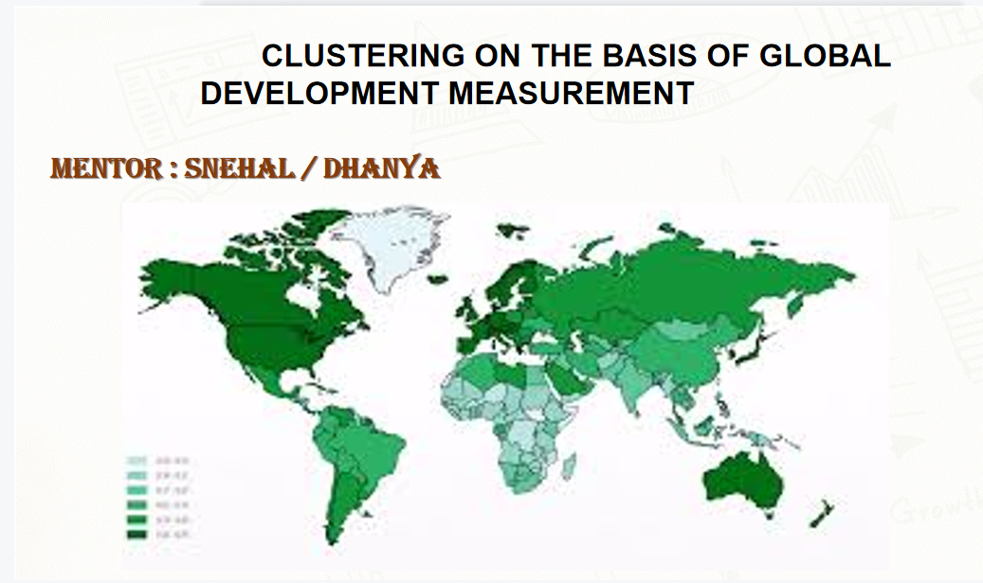
Clustering

Slide 3
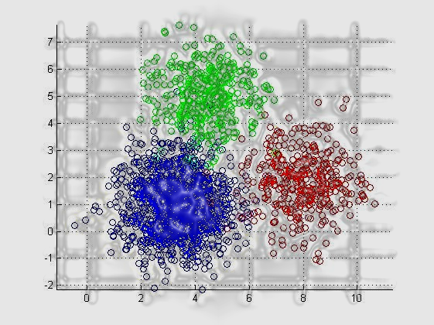
Business Problem:
Creating clusters on global development measurement dataset.
Objective:
The objective of the analysis is to form clusters based on the given global development measurement data.

Slide 4
Project Architecture / Project Flow
Data Exploration
Dataset:
Rows: 2704
Features: 25
EDA and Visualization
Missing values are present in all the features except “Country” & “Population Total”. Created different Visualizations like (Boxplot, Distribution plots, bar plots, histograms, etc.,) to understand the patterns in the data.
Data Pre-processing
Ease of Business & Number of Records features are dropped from the dataset.
Removed special characters ($, %) before numbers.
Converted few features to numeric datatype from Object type. Used mean & KNN based imputation techniques.
Deployment
We deployed the model using Streamlit.
Model Performance
Using Elbow Curve to get optimal Clusters.
Performance is calculated through Silhouette's Score and distance between means of each cluster.
We performed random forest as a classification model
Model Building
Planning to build models like
K-Means Clustering & Hierarchical Clustering

Slide 5
Exploratory Data Analysis (EDA)

Slide 6
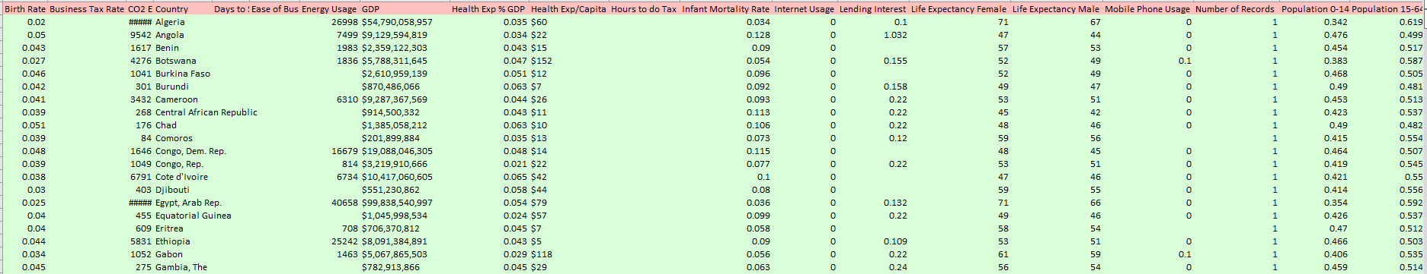
Data set details
No. of Rows: 2704
No. of Features: 25
No. of Categorical Features: 1
No. of Continuous Features: 24
Screenshot of the Dataset

Slide 7
What we done with our data:
Data set details
Describing data
Removing symbols & convert object into float
Missing values
Dropping column
Unique count and unique values of each column.
Duplicate values
Correlation
Renaming columns
Histogram
Outliers
Visualizations
EDA Analysis by Using Pandas Profiling

Slide 8
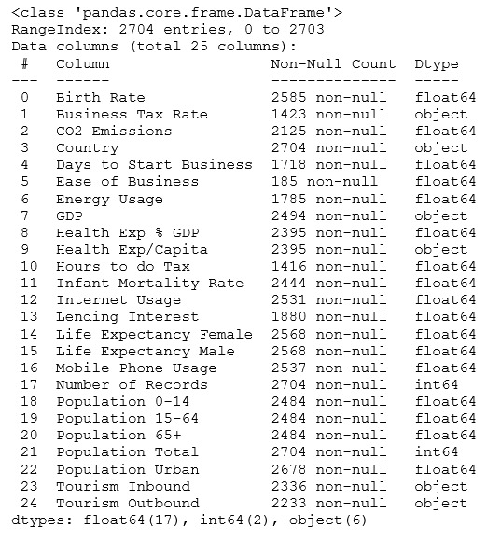
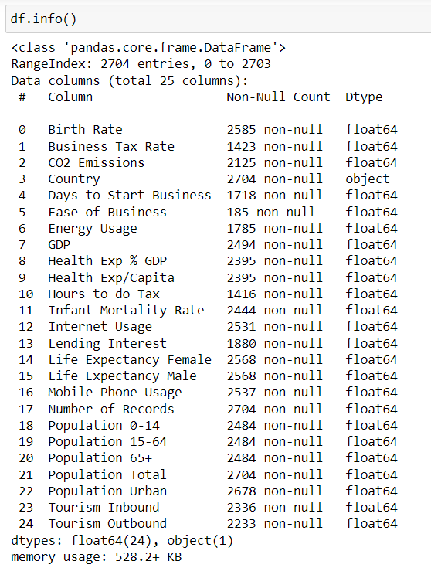
BEFORE AFTER
Converted the datatype from object to numeric float. And filled the null values with mean of each column.

Slide 9
Exploratory Data Analysis (EDA)
Identified null values in the dataset, all the features are having null values except “Country” & “Population Total” features.
Feature wise Percentage of Null Values
Feature | % of Null Values
birth_rate | 4.400888
business_tax_rate | 47.37426
co2_emission | 21.412722
country | 0
days_to_start_business | 36.464497
energy_usage | 33.986686
GDP | 7.766272
health_exp%_GDP | 11.427515
health_exp_percapita | 11.427515
hours_to_do tax | 47.633136
infant_mortality_rate | 9.615385
internet_usage | 6.397929
lending_interest | 30.473373
life_expectancy_female | 5.029586
life_expectancy_male | 5.029586
moble_phone_usage | 6.176036
population_0_14 | 8.136095
population_15_64 | 8.136095
population_65+ | 8.136095
population_total | 0
population_urban | 0.961538
tourism_inbound | 13.609467
tourism_outbound | 17.418639

Slide 10
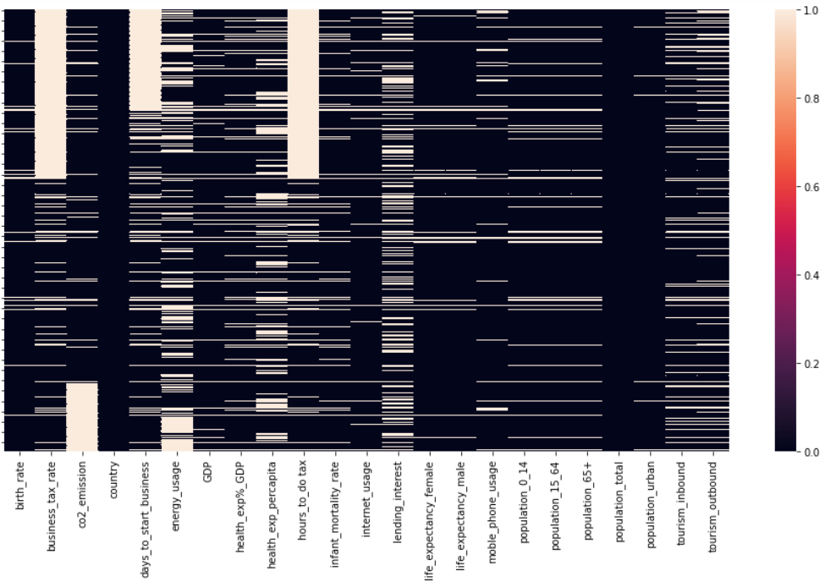
Heatmap to Visualize Null Values in the Dataset
Hours to do tax and Business tax rate are having high null values

Slide 11
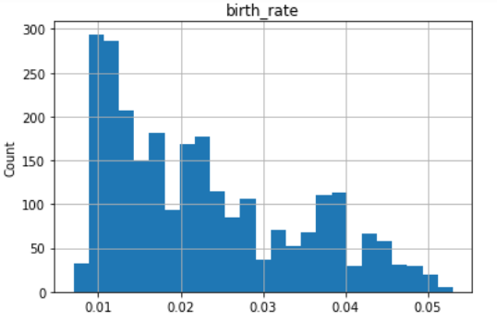
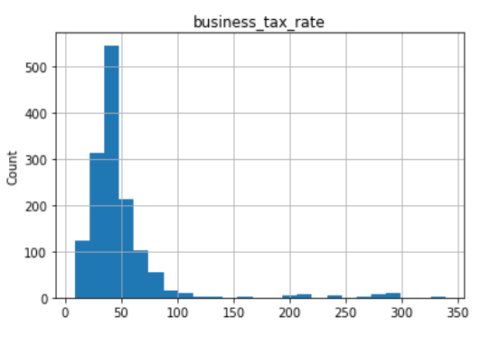
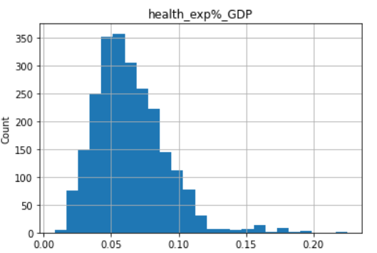
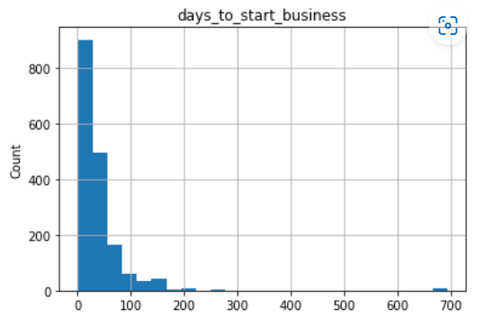
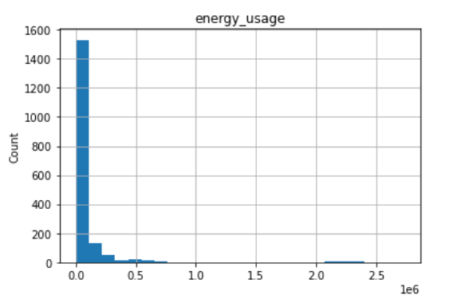
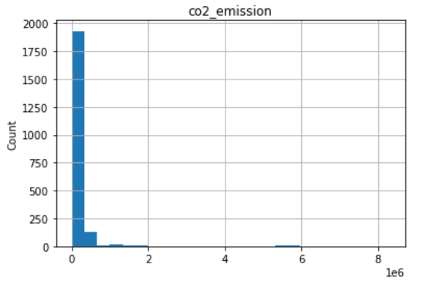
Histograms to visualize the distribution of the data

Slide 12
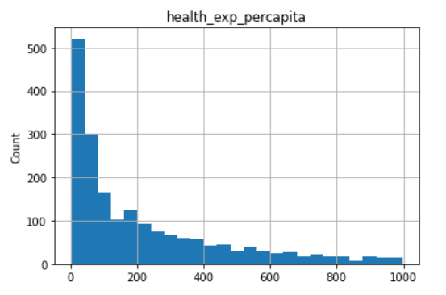
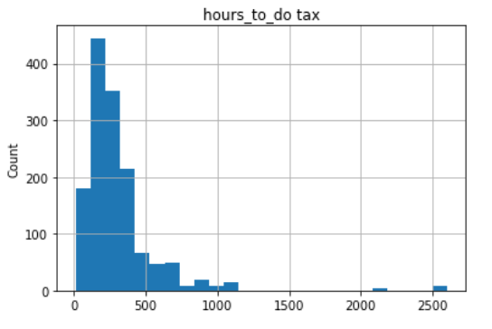
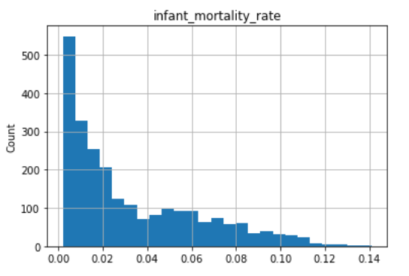
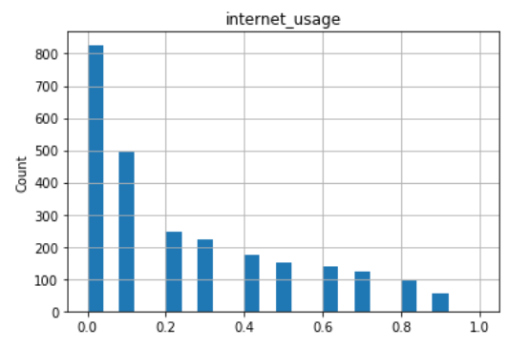
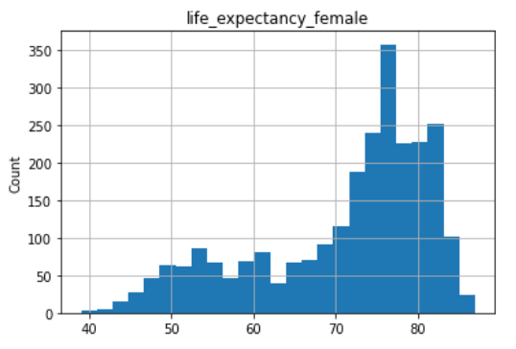
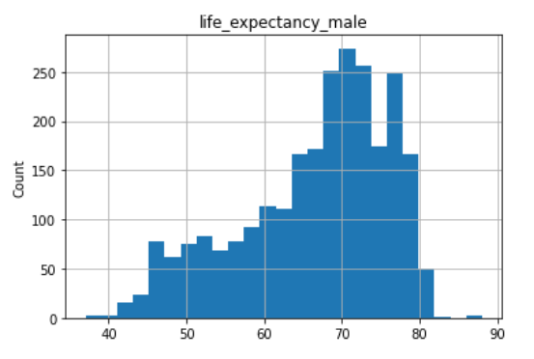
Histograms to visualize the distribution of the data

Slide 13
Histograms
Data Distribution: lending_interest, GDP, population_total, co2_emission, days_to_start_business, tourism_inbound, energy_usage, tourism_outbound features are highly skewed.
Range and Spread: By observing the width of the histogram, we can understand the range and spread of the data.
Outliers: Histograms can help identify outliers, which are data points that significantly deviate from the majority of the data. Business_tax_rate have high outliers.

Slide 14
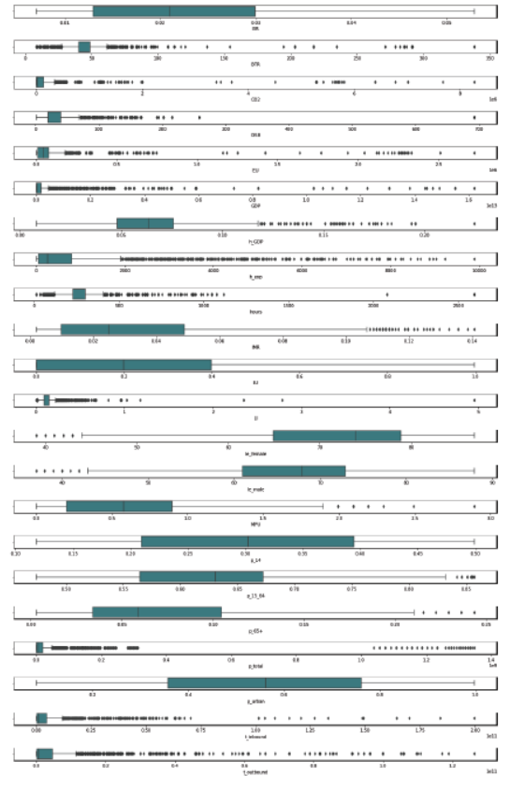
Exploratory Data Analysis (EDA)
.
Box plot representing that there are outliers in some of the columns of the data
Box Plot

Slide 15
Interpretations on Boxplots
High Outliers
business_tax_rate
co2_emission
days_to_start_business
energy_usage
GDP
health_exp%_GDP,
health_exp_percapita
hours_to_do tax
population_total
tourism_inbound
tourism_outbound
Few Outliers
infant_mortality_rate
life_expectancy_female
life_expectancy_male
moble_phone_usage
population_15_64
population_65+

Slide 16
Features Engineering

Slide 17
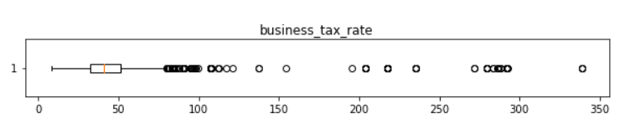
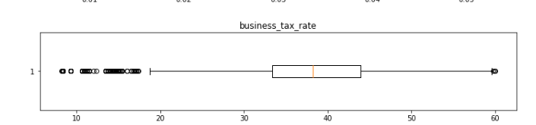
Interpretations on Boxplots
max(Business Tax Rate) is around 340% , which means paying 340 rupees as tax for every 100 rupees profit. The global highest Business Tax Rate is around 55% , so assuming the max value to be 60% and replacing all the ouliers (i.e., above 60%) with np.nan and will fill them later using imputation techniques.

Slide 18
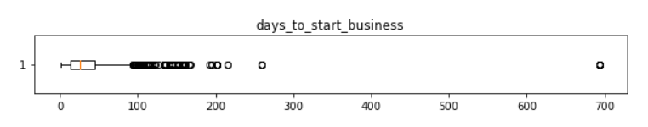
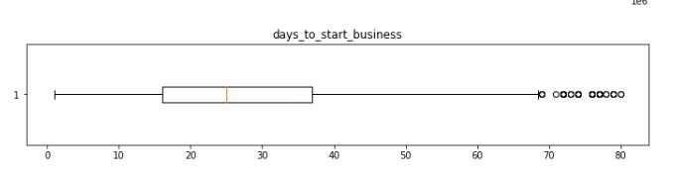
Interpretations on Boxplots
max(Days to Start Business) is 694 days. Accounting 18-20 business days a month it takes like around 3 years , comparing it to real time global values, the max time required to start a business is around 50 days. Based on the boxplot assuming the max days to start a business is 80 days and replacing all the outliers with np.nan and will figure a way to fill them up with sensible number later based on all other parameters

Slide 19
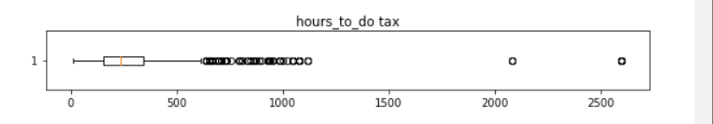
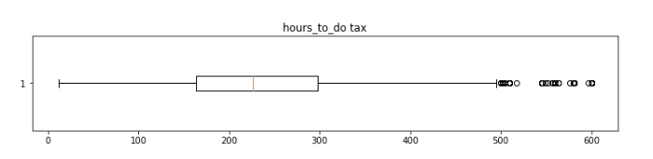
Interpretations on Boxplots
Based on the boxplot assuming 600 hours as max (hours to do tax ) and replacing all the outliers with np.nan and will figure a way to fill them up with sensible number later based on all other parameters.

Slide 20
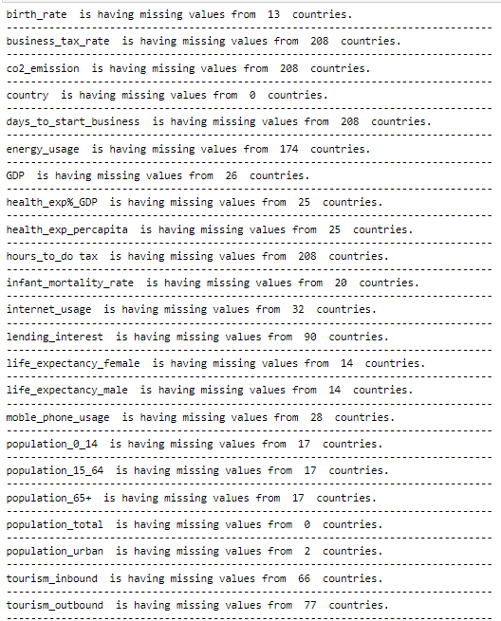
Country & Feature wise Mean Imputation
Imputing missing values with country and feature wise mean, as if the imputation is done through the mean of feature may mislead the data.
Afghanistan doesn’t have any values. So, for that we performed median.

Slide 21
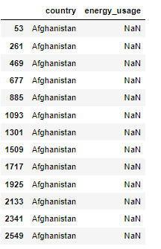
Median Imputation
Whichever countries having null values for the entire feature, imputing those countries with median value of that feature from all the countries.
Tried with KNN Imputation as well for whichever countries having null values for the entire feature, but median imputation is giving better results, hence going ahead with median imputation

Slide 22
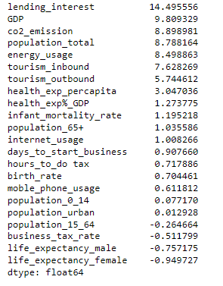
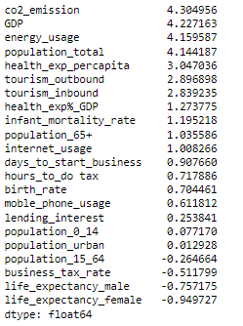
Data Transformations
Applying log transformation for lending_interest feature
Applying Square root transformation for 'GDP', 'co2_emission', 'population_total', 'energy_usage', 'tourism_inbound', 'tourism_outbound' features

Slide 23
Visualization

Slide 24
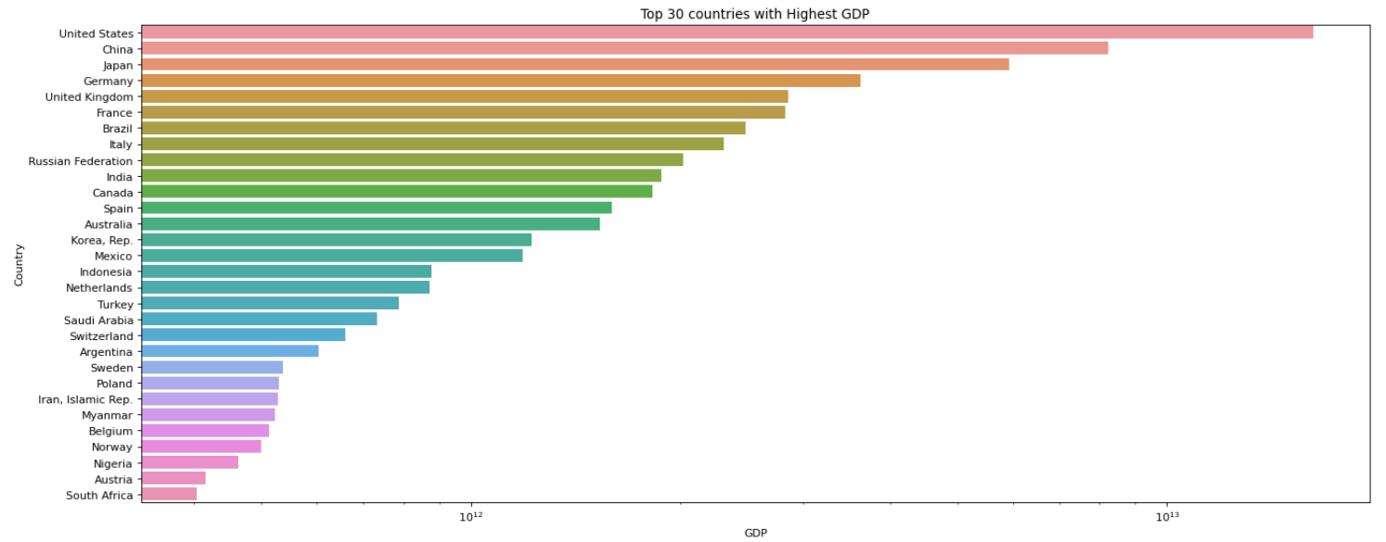
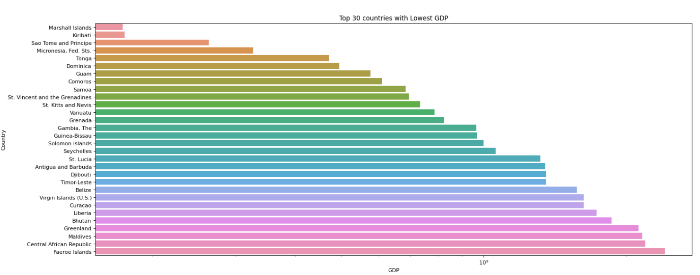
Top 30 Countries with Highest GDP
US have high GDP and Marshall islands have low GDP
Top 30 Countries with Lowest GDP

Slide 25
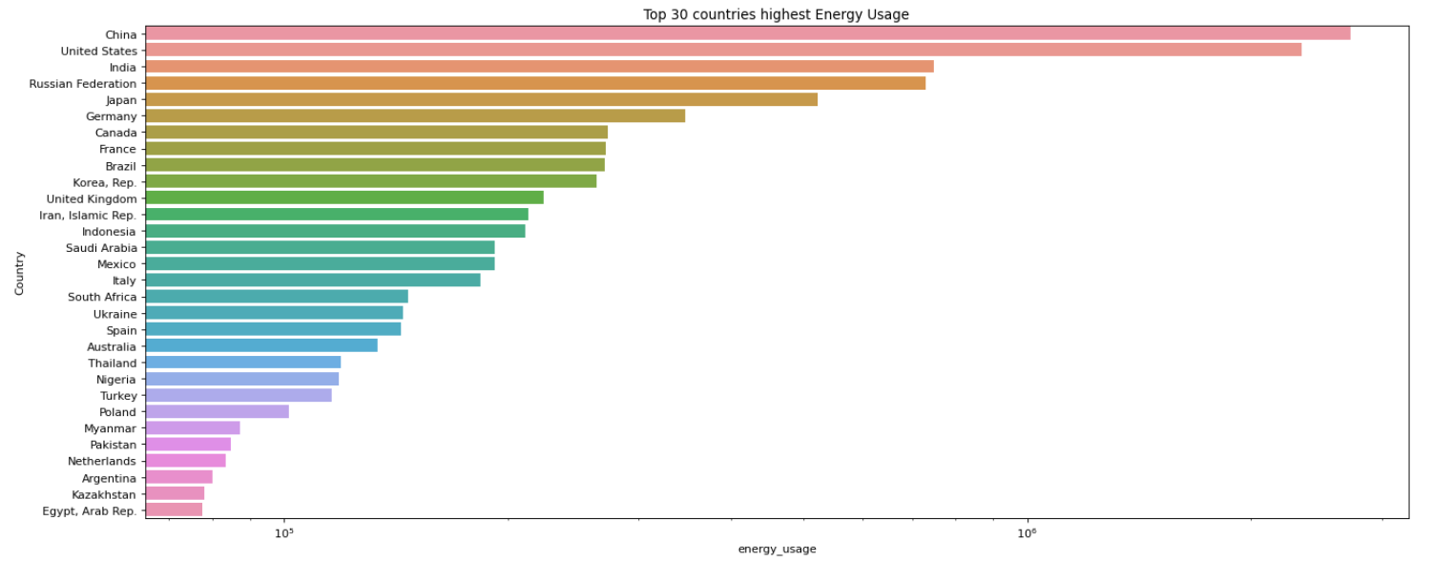
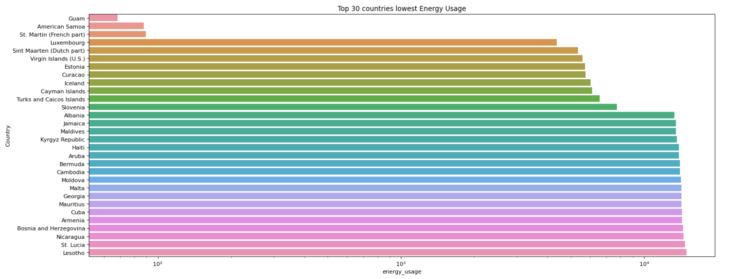
Top 30 Countries with Highest Energy Usage
China have highest energy usage and Guam have lowest energy usage
Top 30 Countries with Lowest Energy Usage

Slide 26
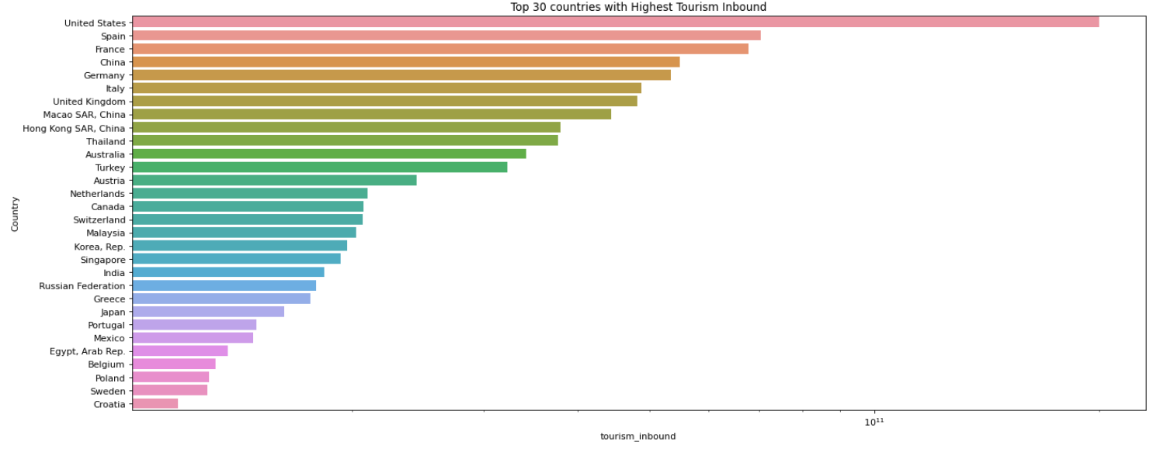
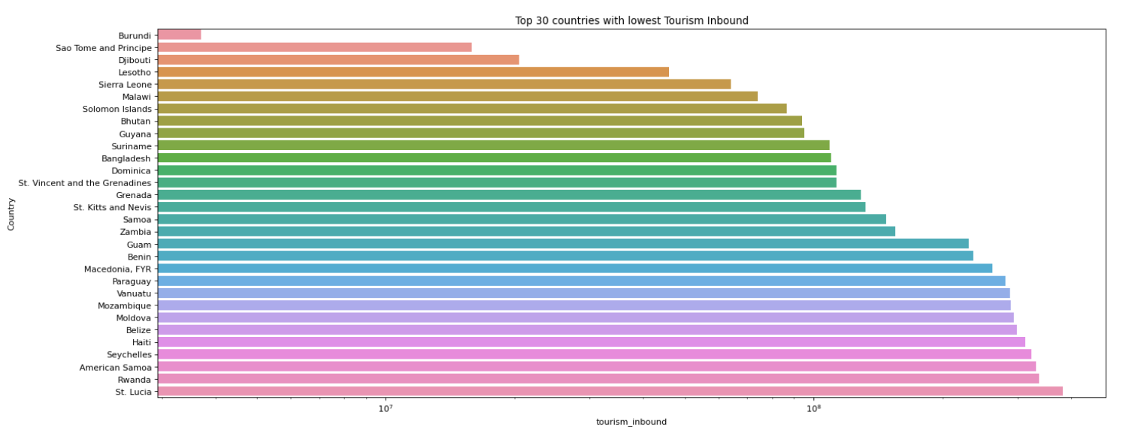
Top 30 Countries with Highest Tourism Inbound
US have highest tourism Inbound and Burundi have lowest energy usage
Top 30 Countries with Lowest Tourism Inbound

Slide 27
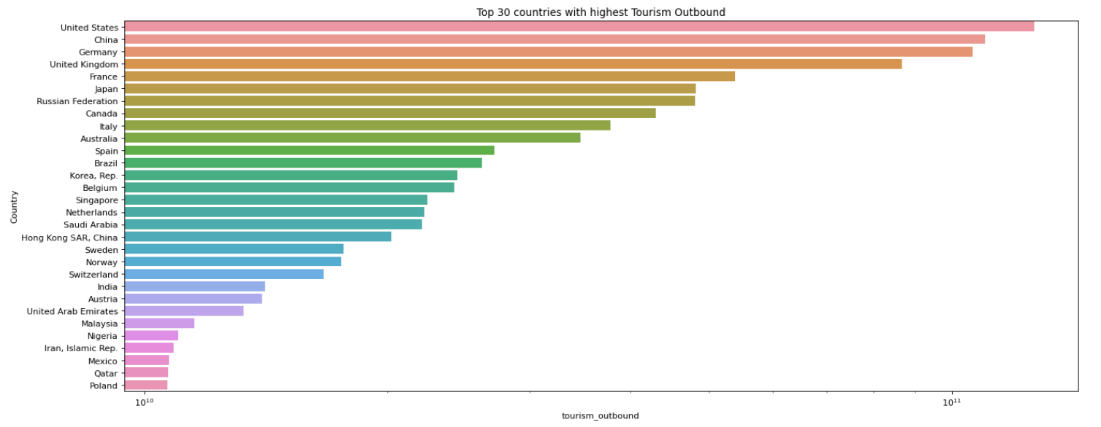
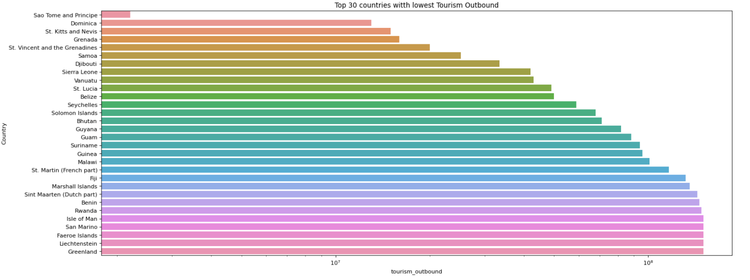
Top 30 Countries with Highest Tourism Outbound
US have highest tourism outbound and sao Tome and Principe have lowest energy usage
Top 30 Countries with Lowest Tourism Outbound

Slide 28
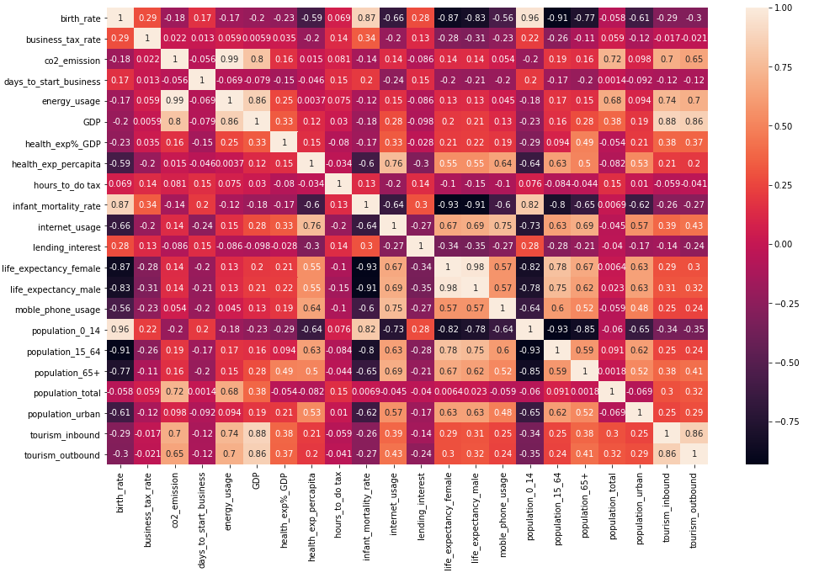
Correlation Heatmap
CO2 and energy usage are having more correlation of 0.99 with each other than any variables

Slide 29
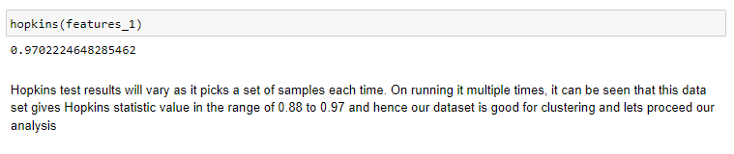
Hopkins test
Hopkins test is a way of measuring the cluster tendency of a dataset the Hopkins statistic, is a statistic which gives a value which indicates the cluster tendency, in other words: how well the data can be clustered.
If the value is between {0.7, ..., 0.99}, it has a high tendency to cluster measuring
We determined that the clustering techniques we used are appropriate for a given dataset

Slide 30
PCA[Principal Component Analysis]

Slide 31
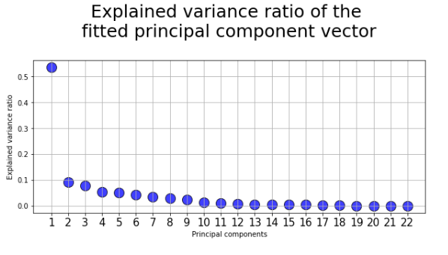
Principal Component Analysis
The sum of first three variance we got 70.5%. So we made a choice to take 3 PCA values.

Slide 32
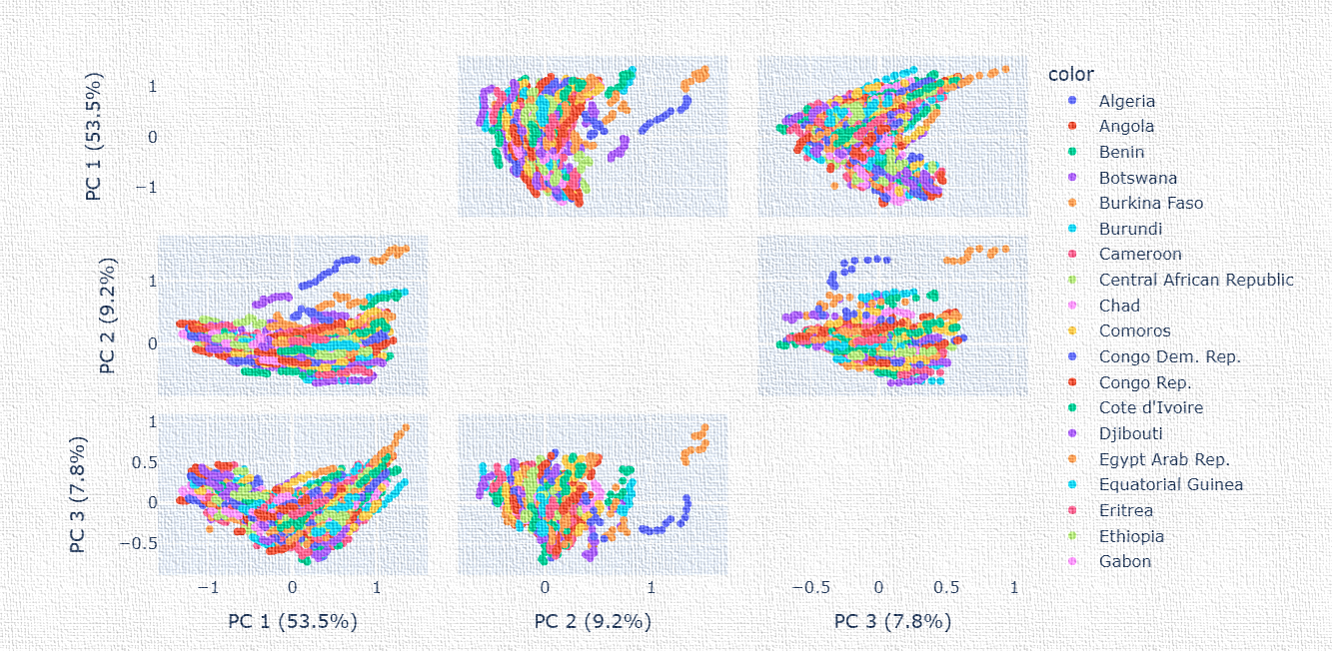
Based on country PCA1= 53.5%
PCA2 = 09.2%
PCA3 = 07.8%
We got 70.5% in adding sum of first three variance.

Slide 33
Model Building

Slide 34
Hierarchical Clustering
START
Why Hierarchical clustering?
We can obtain the optimal number of clusters from the model itself, human intervention not required.
Dendrograms help us in clear visualization, which is practical and easy to understand.
Input features
Compute distance matrix
Set each point as cluster
No. of cluster=1
End
Merge closest cluster
Update distance matrix

Slide 35
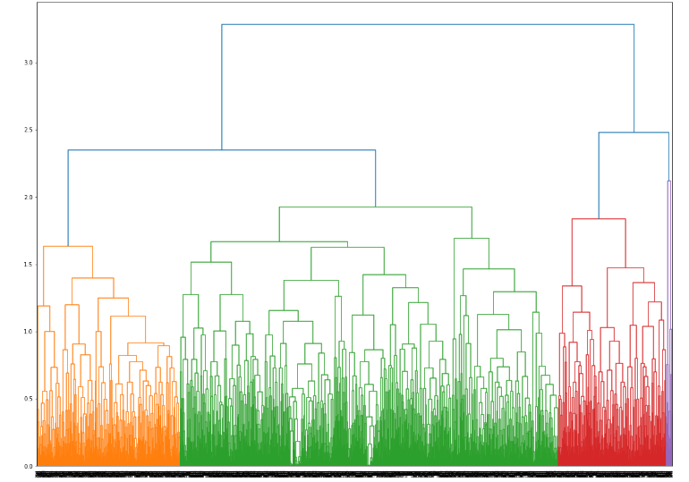
Agglomeritive or Hierarchical Clustering
As we have a lot of Outliers, we are unable to get good silhouette scores
Silhouette score: 0.256035

Slide 36
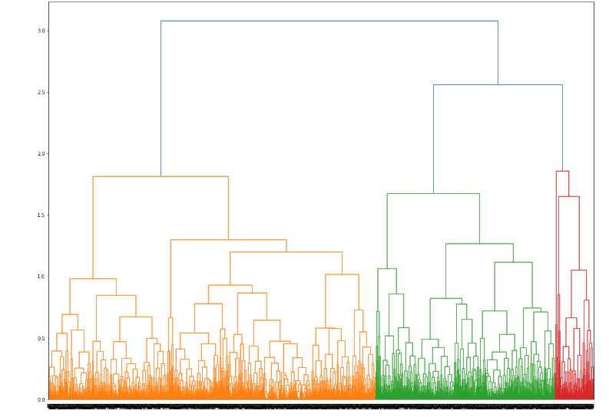
Agglomeritive or Hierarchical Clustering [after PCA]
As we have a lot of Outliers, we are unable to get good silhouette scores
Silhouette score: 0.256035
As we have a lot of Outlliers, we are unable to get good silhouette scores
Silhouette score: 0.256035

Slide 37
K-Means Clustering
START
Why Kmean?
Easy to implement
Apply for large data
Generalizes to clusters of different shapes and sizes, such as elliptical clusters.
No. ok clusters k
Determine the centroids
Calculating the distance
Group the clusters
Moved to cluster?
End

Slide 38
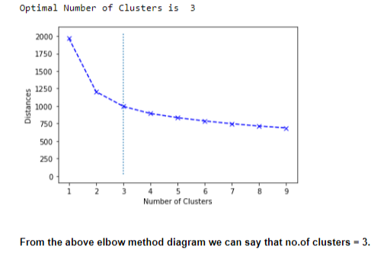
K-Means Clustering
As we have a lot of Outliers, we are unable to get good silhouette scores
Silhouette score: 0.2507

Slide 39
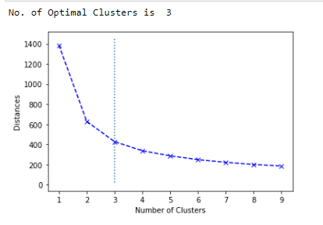
K-Means Clustering [after PCA]
Silhouette score: 0.41021

Slide 40
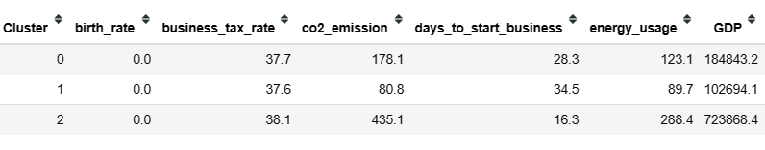
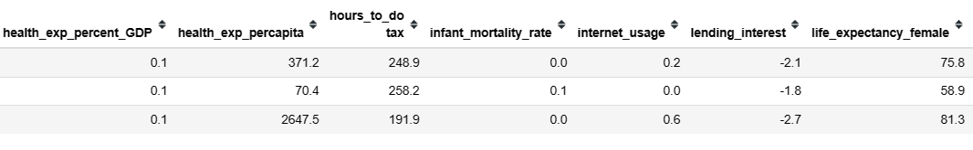
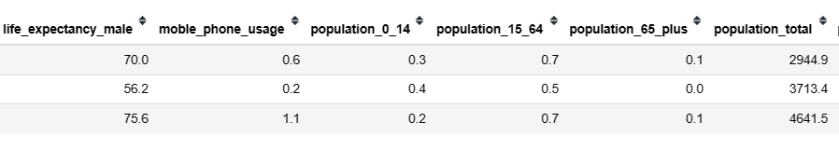
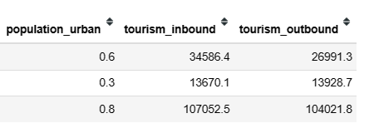
Cluster wise feature means

Slide 41
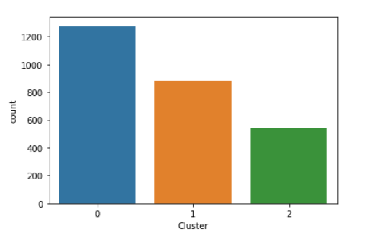
Count plot for Clusters
The bar chart shows distribution of data points among different clusters. It allows us to easily observe the count of data points belonging to each cluster.

Slide 42




Histogram for Clusters
The histograms of each cluster for each column in your dataset

Slide 43

After we performed clustering…
Each rows are labeled
Now it is a Classification problem
Spilt the data as training and testing part
Train and Test the model accuracy using Random Forest
Our prediction will be of 97% Accuracy level by using random forest classifier.

Slide 44
Deployment of model

Slide 45
Deployment of model
1. Create a Python script for user interface
2. Create a pkl file with a trained model
3. Load the trained model
4.Install Streamlit
7. Run the Streamlit app
6.Implement model inference
5. Using streamlit we deploy the model

Slide 46

Deployment of model

Slide 47


Slide 48


Slide 49


Slide 50
Issue faced during project
Dealing with Nan values
We tried mean, median and also knn
Finally, we choose mean for some columns
And, median for some columns.
Difficulty while handling Outliers
We understand the data
We figured the global values for columns
And, changed them into Nan values.

Slide 51
Spend quality of time for analyzing the data.
Importance of Virtualization
Outlier detection
Cluster behavior
Communication and presentation
What we learn…
Anomaly detection before performing models makes our model better.
Give importance to EDA from the beginning itself.

Slide 52
Thank you

